Slide 1
Chapter 3: Using Variables and Constants
Lesson B & C

Slide 2
Lesson B Objectives
After studying Lesson B, you should be able to:
Include procedure-level and class-level variables in an application
Concatenate strings
Get user input using the InputBox function
Include the ControlChars.NewLine constant in code
Designate the default button for a form
Format numbers using the ToString method

Slide 3
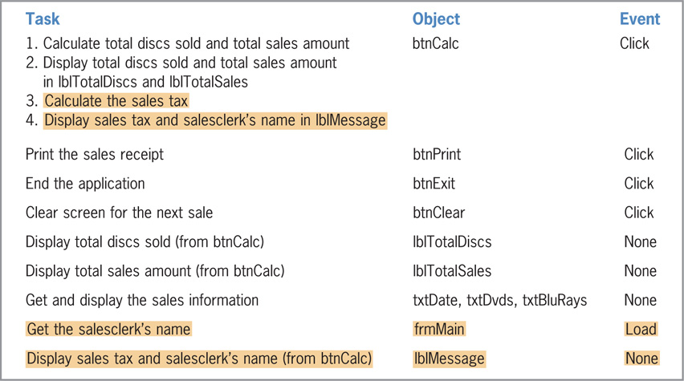
Modifying the Play It Again Movies Application
Modifications needed
Calculate and display
the sales tax
Display salesperson’s name
Revise the TOE chart to reflect the new tasks
You must modify btnCalc button’s Click event and the form’s Load event
Figure 3-26 Revised TOE chart for the Play It Again Movies application

Slide 4
Open Play It Again From ANGEL

Slide 5
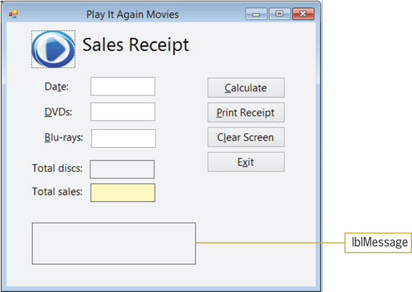
Modifying the Play It Again Movies Application (cont.)
Figure 3-27 Modified user interface for the Play It Again Movies application

Slide 6
Modifying the Calculate Button’s Code
General strategy
Remove the existing code from the Click event procedure
Recode the procedure using variables in equations
Use the Option Explicit On statement
Enforces full variable declaration
Use the Option Infer Off statement
Ensures that variables are declared with data types
Use the Option Strict On statement
Suppresses implicit type conversions

Slide 7
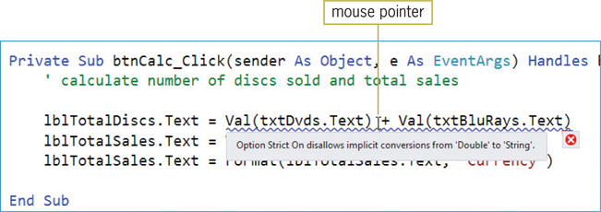
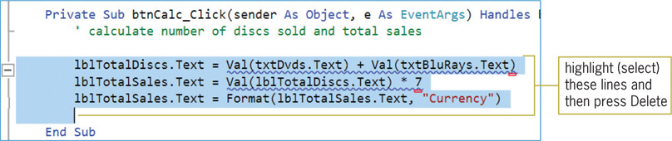
Modifying the Calculate Button’s Code (cont.)
Figure 3-28 A jagged blue line indicates a syntax error
Figure 3-29 Lines to delete from the procedure

Slide 8
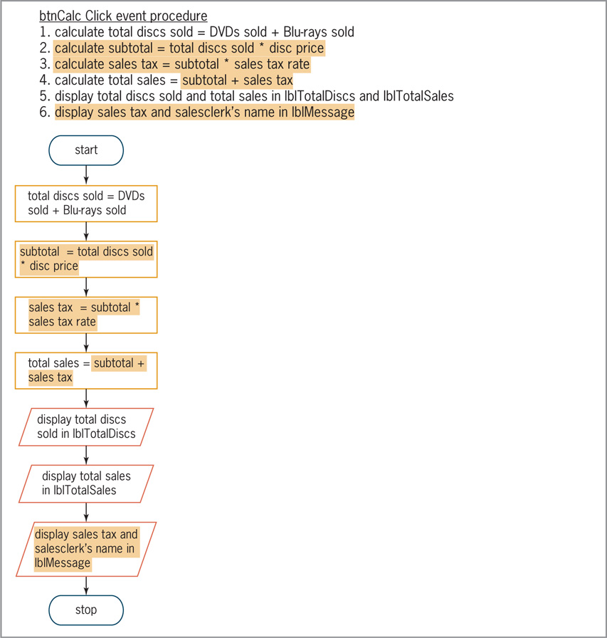
Modifying the Calculate Button’s Code (cont.)
Figure 3-30 Revised pseudocode and flowchart for the btnCalc control’s Click event procedure

Slide 9
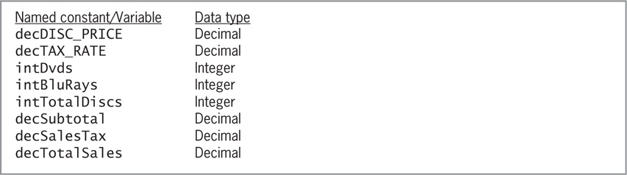
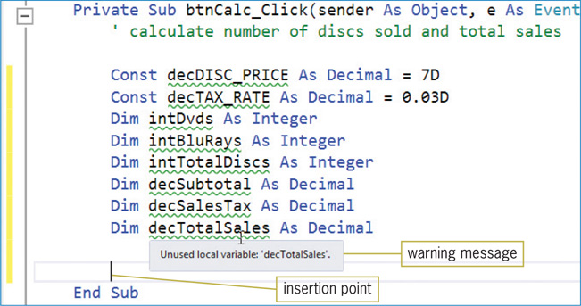
Modifying the Calculate Button’s Code (cont.)
Figure 3-31 List of named constants and variables
Figure 3-32 Const and Dim statements entered in the procedure

Slide 10
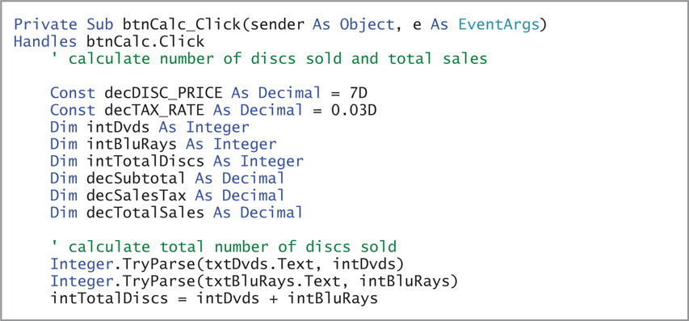
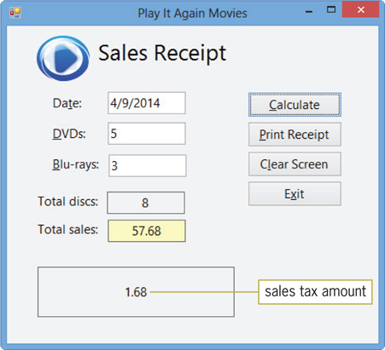
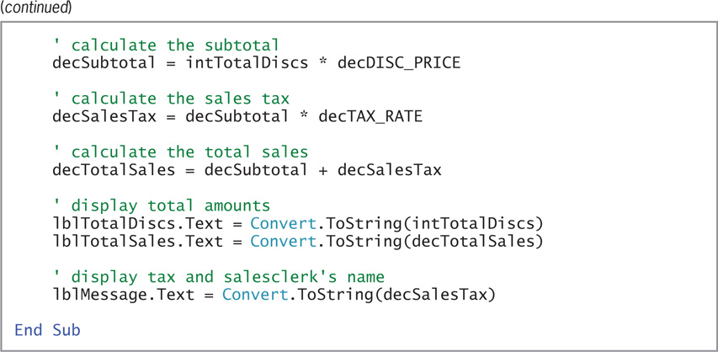
Modifying the Calculate Button’s Code (cont.)
Figure 3-34 Calculated amounts shown in the interface
Figure 3-33 Code entered in the btnCalc control’s Click event procedure

Slide 11
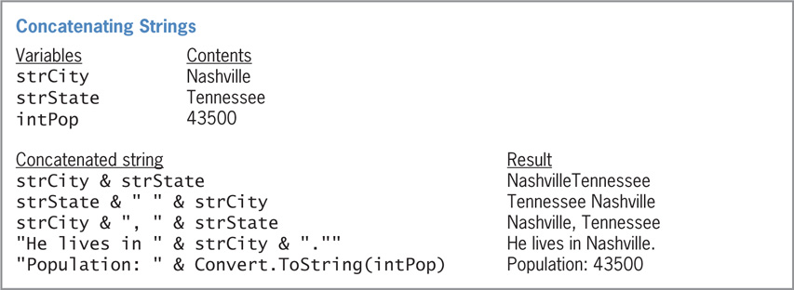
Concatenating Strings
Concatenate
To connect strings together
Concatenation operator
The ampersand (&)
Include a space before and after the ampersand
Numeric values used with the & operator are converted to strings
Figure 3-35 Examples of string concatenation

Slide 12
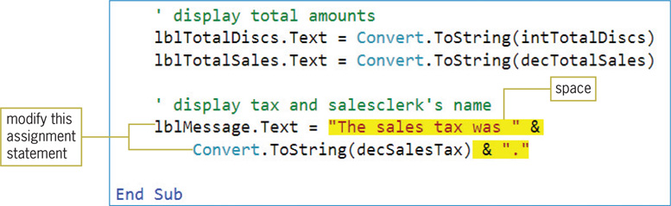
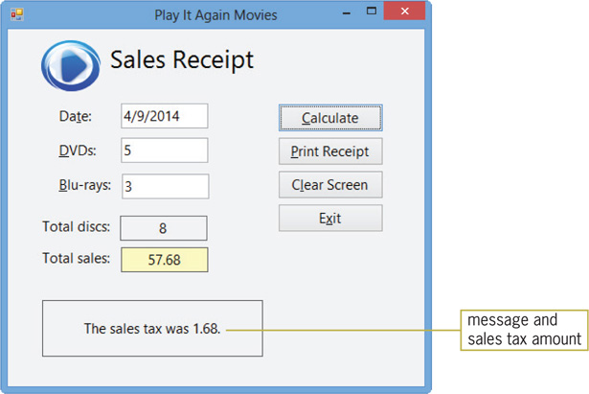
Concatenating Strings (cont.)
Figure 3-36 String concatenation included in the assignment statement
Figure 3-37 Concatenated strings displayed in the lblMessage control

Slide 13
The InputBox Function
InputBox function
Displays an input dialog box and retrieves user input
Arguments
prompt: Contains the message to display inside the dialog box
title: Controls the text that appears in the dialog box’s title bar
defaultResponse: Controls the text that appears in the input field
The returned value most often assigned to String variable
The syntax is shown in Figure 3-39 on the next slide

Slide 14
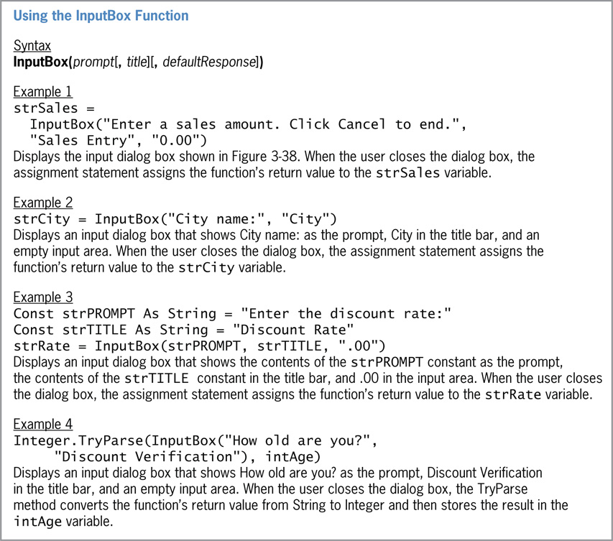
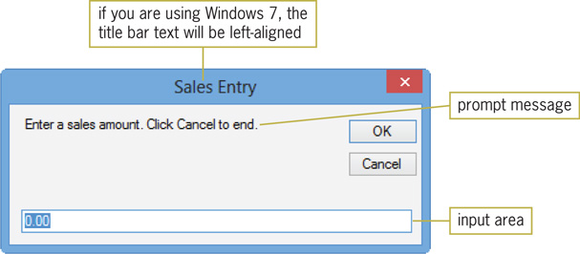
The InputBox Function (cont.)
Figure 3-38 Example of an input dialog box
Figure 3-39 Basic syntax and examples of the InputBox function

Slide 15
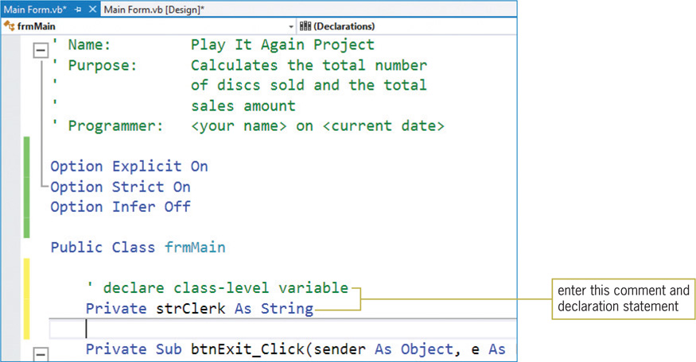
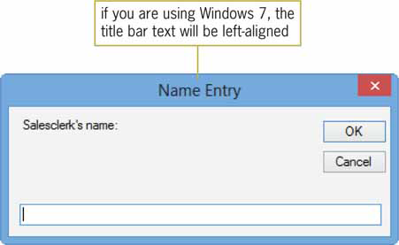
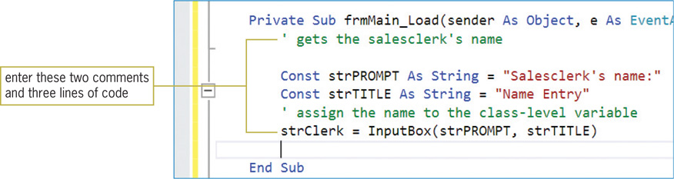
The InputBox Function (cont.)
Figure 3-42 Dialog box created by the InputBox function
Figure 3-40 Class-level variable declared in the form’s Declarations section
Figure 3-41 frmMain Load event procedure

Slide 16
The ControlChars.Newline Constant
ControlChars.NewLine constant
Advances the insertion point to the next line in a control
Also used to advance the insertion point in file or on the printer
To use, type ControlChars.NewLine in the appropriate location
Can be used with string concatenation
Line continuation character (_)
Used to break up a long line of code into two or more lines

Slide 17
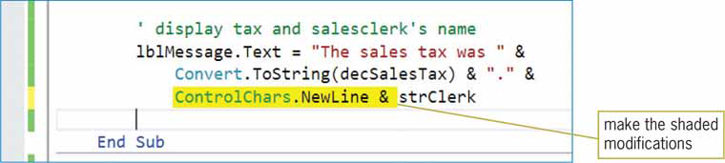
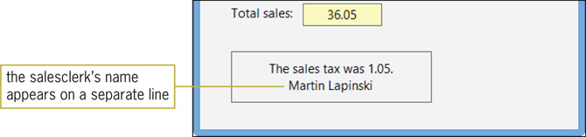
The ControlChars.Newline Constant (cont.)
Figure 3-43 Modified assignment statement
Figure 3-45 Salesclerk’s name shown on the sales receipt

Slide 18
Designating a Default Button
Default button
Activated by pressing the Enter key
Not required to have the focus
Only one per form
The default button should be the button used most often by the user
Except if button’s task is destructive and irreversible, such as deleting data
Set the form’s AcceptButton property to the button name

Slide 19
Using the ToString Method to Format Numbers
Formatting
Specifying decimal places and special characters to display
The ToString method replaces the Format function
Syntax: variablename.ToString(formatString)
variablename: The name of a numeric variable
formatString: The string specifying the format you want to use
formatString must take the form Axx, where A is the format specifier and xx is the precision specifier

Slide 20
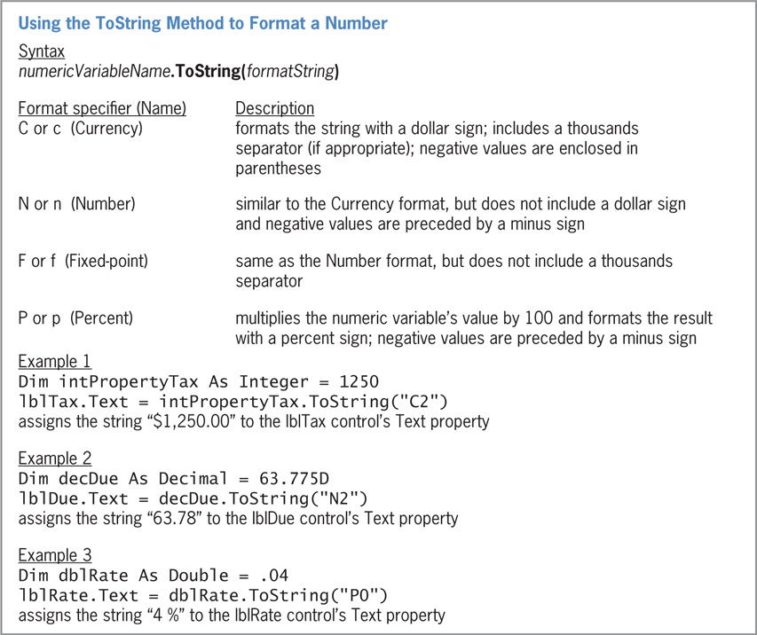
Using the ToString Method to Format Numbers (Cont.)
Figure 3-46 Syntax and examples of the ToString method

Slide 21
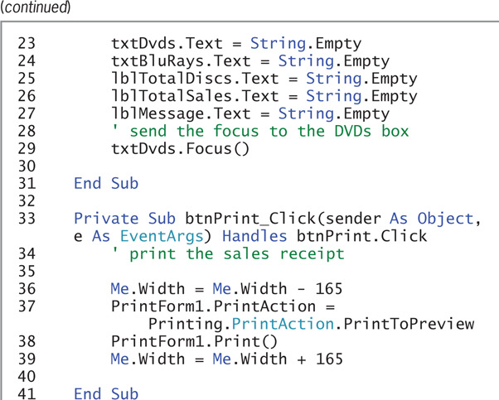
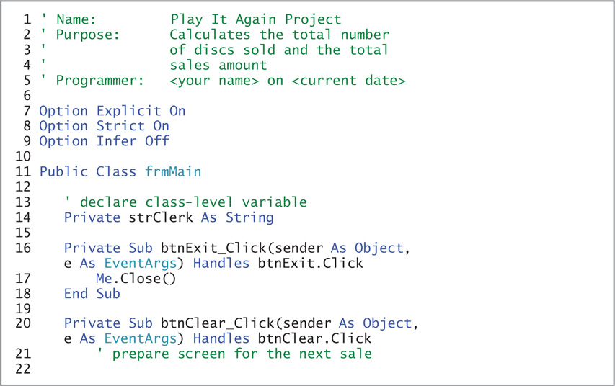
Using the ToString Method to Format Numbers (Cont.)
Figure 3-48 Play It Again Movies application’s code at the end of Lesson B (continues…)

Slide 22
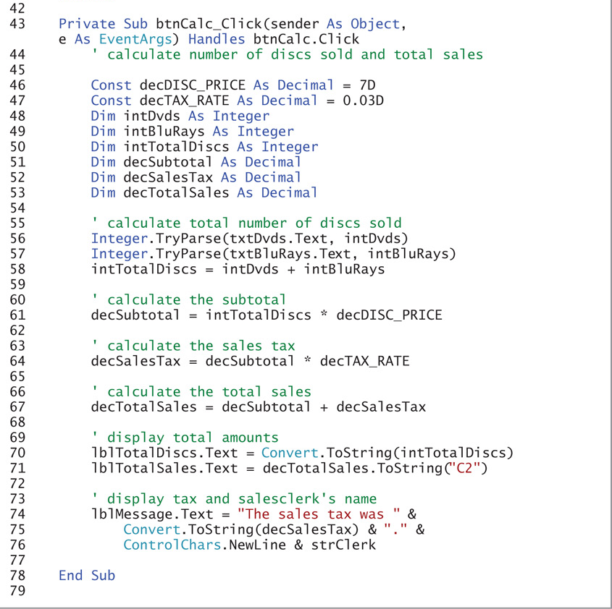
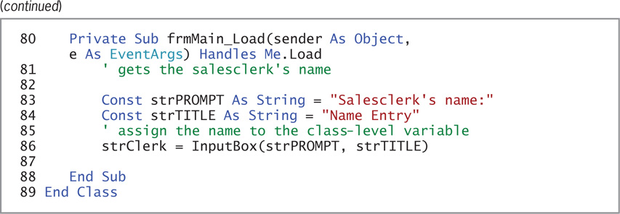
Using the ToString Method to Format Numbers (Cont.)
Figure 3-48 Play It Again Movies application’s code at the end of Lesson B

Slide 23
Lesson B Summary
The concatenation operator (&) is used to link strings
The InputBox function displays an interactive dialog box
Use ControlChars.NewLine to move the insertion point to a new line
Set the default button in the form’s AcceptButton property
The ToString method formats a number for string output

Slide 24
Lesson C Objectives
After studying Lesson C, you should be able to:
Include a static variable in code
Code the TextChanged event procedure
Create a procedure that handles more than one event

Slide 25
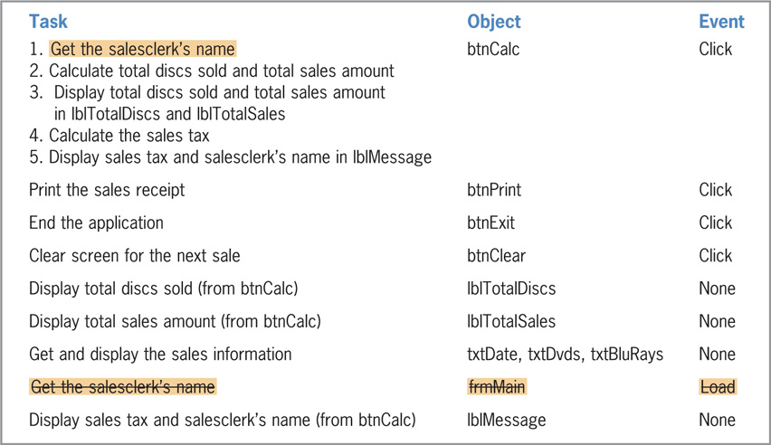
Modifying the Load and Click Event Procedures
Figure 3-51 Revised TOE Chart for the Play It Again Movies application in Lesson C

Slide 26
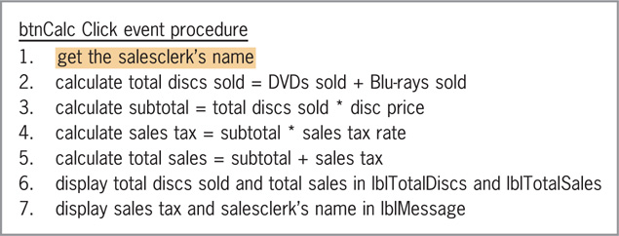
Modifying the Load and Click Event Procedures (Cont.)
Figure 3-52 Revised pseudocode for the Calculate button in Lesson C

Slide 27
Coding the TextChanged Event Procedure
TextChanged event
Occurs when the Text property value of a control changes
Can occur when:
The user enters data into the control
The code assigns data to the control’s Text property
Example: A change is made to the number of items ordered

Slide 28
Coding the TextChanged Event Procedure (Cont.)
Associating a Procedure with Different Objects and Events
Handles clause
Appears in an event procedure’s header
Indicates the object and event associated with the procedure
You can associate an event procedure with more than one object and/or event
In the Handles section of procedure header, list each object and event separated by commas
Procedure names are entered in Pascal case
Capitalize the first letter in the name and the first letter of each subsequent word in the name

Slide 29
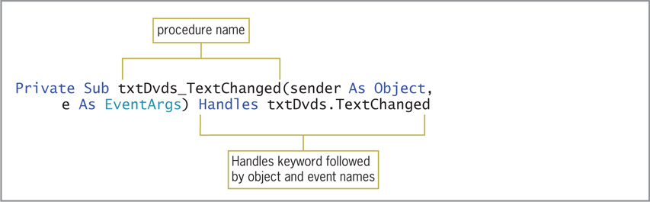
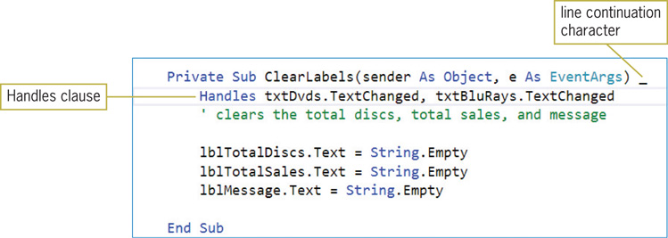
Coding the TextChanged Event Procedure (cont.)
Figure 3-53 TextChanged event procedure associated with the txtDvds control
Figure 3-54 Completed ClearLabels procedure

Slide 30
Lesson C Summary
The TextChanged event procedure responds to a change in the value of a control’s Text Property
The Handles clause determines which objects and events are associated with the event procedure
To create a procedure for more than one object or event, list each object and event after the Handles keyword

